Slide 1
Module B
Unit B3
Vocabulary
Language Functions
Speaking Activities
UTN FRVM Lic. Evangelina Cecchel - Lic. Bibiana Fernandez

Slide 2
Unit B1
Language Functions
Making requests
UTN FRVM Lic. Evangelina Cecchel - Lic. Bibiana Fernandez

Slide 3
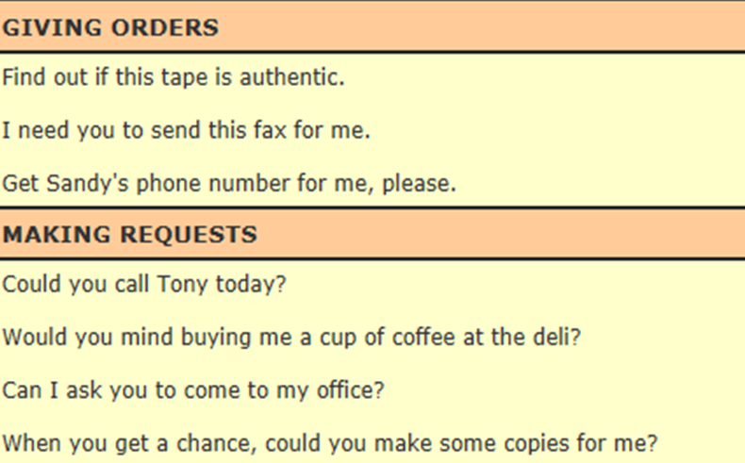
UTN FRVM Lic. Evangelina Cecchel - Lic. Bibiana Fernandez

Slide 4
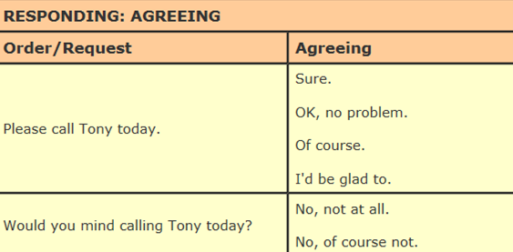
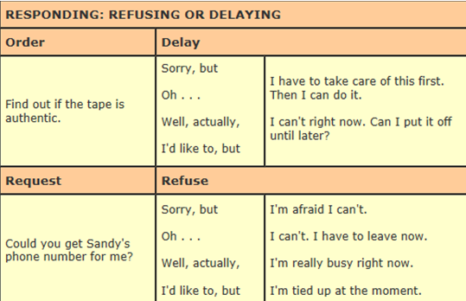
UTN FRVM Lic. Evangelina Cecchel - Lic. Bibiana Fernandez

Slide 5
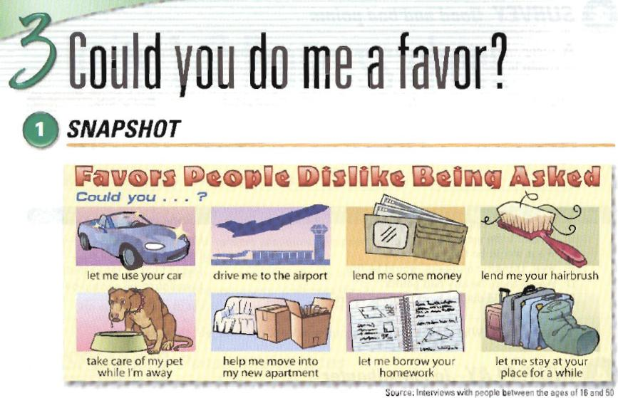
UTN FRVM Lic. Evangelina Cecchel - Lic. Bibiana Fernandez

Slide 6
Language Functions
Talking about possibilities
UTN FRVM Lic. Evangelina Cecchel - Lic. Bibiana Fernandez

Slide 7
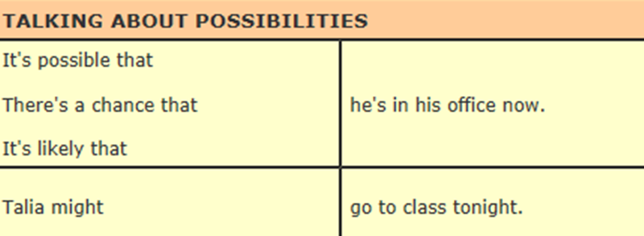
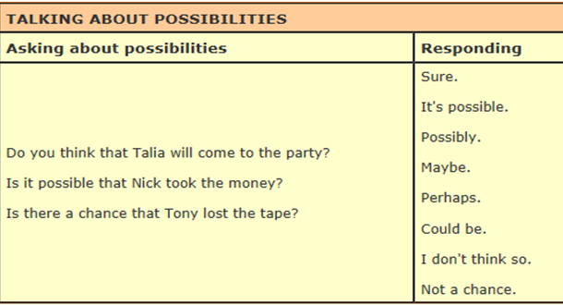
UTN FRVM Lic. Evangelina Cecchel - Lic. Bibiana Fernandez

Slide 8

Is it possible that you will do
these activities next weekend?
UTN FRVM Lic. Evangelina Cecchel - Lic. Bibiana Fernandez

